Slide 1

WPDD202: Webpage Design & Development
Version 2 – 18th December 2015

Slide 2
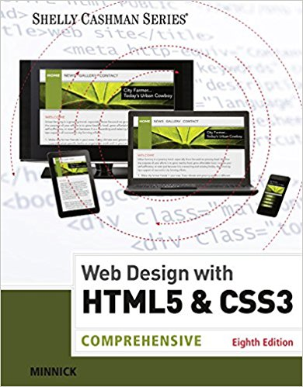
Resource Material
Web Design with HTML & CSS3: Comprehensive, 8th Edition
Jessica Minnick; Lisa Friedrichsen
ISBN-10: 1305578163 | ISBN-13: 9781305578166 © 2017
Cengage Learning Australia

Slide 3
Chapter 10
Creating Pop-Up Windows, Adding Scrolling Messages, and Validating Forms

Slide 4
Chapter Objectives
Write a JavaScript user-defined function to display a scrolling message
Write a JavaScript user-defined function to validate form data
Write a JavaScript user-defined function to calculate a total loan amount based on a sales amount and down payment
Write a JavaScript user-defined function to calculate monthly loan payments

Slide 5
Chapter Objectives
Define if and if...else statements, conditionals, and operands
Write a JavaScript user-defined function to format output in a text field
Describe how to open a pop-up window

Slide 6
Plan Ahead
Determine what you want the code to accomplish
Determine the overall Web page appearance
Determine the data validation requirements
Determine the calculations needed

Slide 7
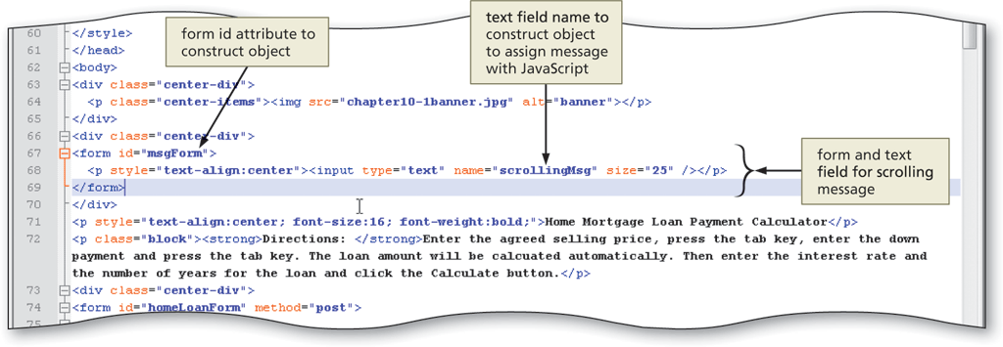

Creating a Form Text Field to Display a Scrolling Message
Filename: index10.html

Slide 8
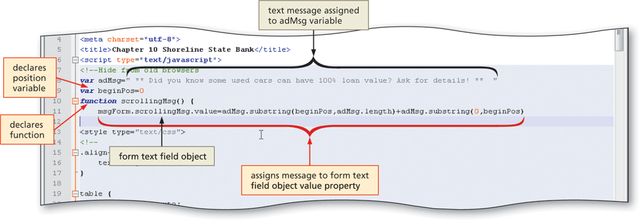
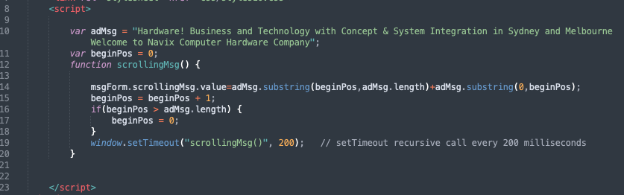
Creating the scrollingMsg() User-Defined Function
Filename: index10.html

Slide 9
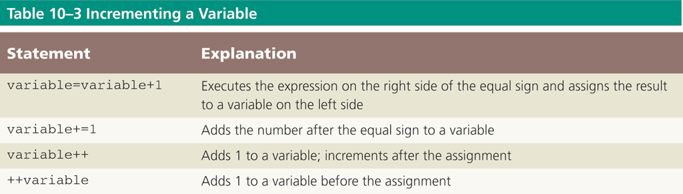
Incrementing a Variable

Slide 10
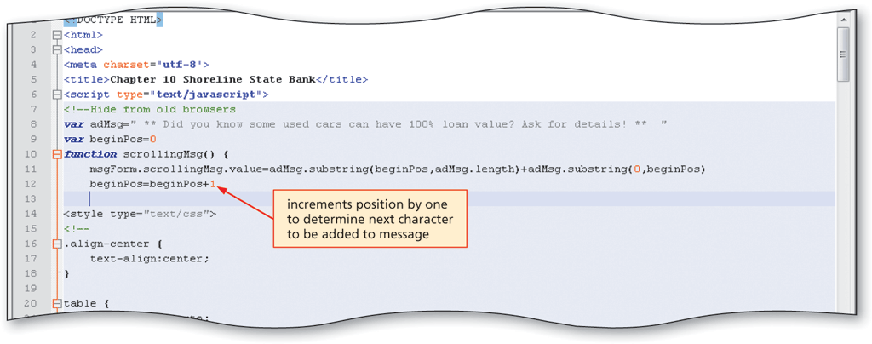
Entering the Code to Increment the Position Locator Variable
Filename: index10.html

Slide 11
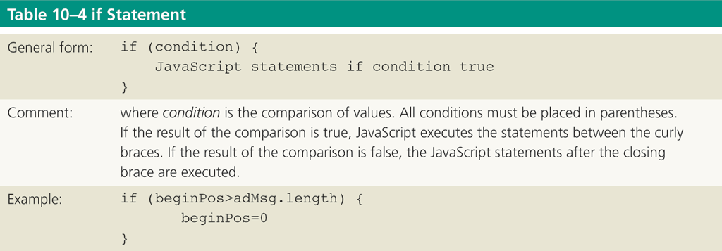
Entering an If Statement

Slide 12
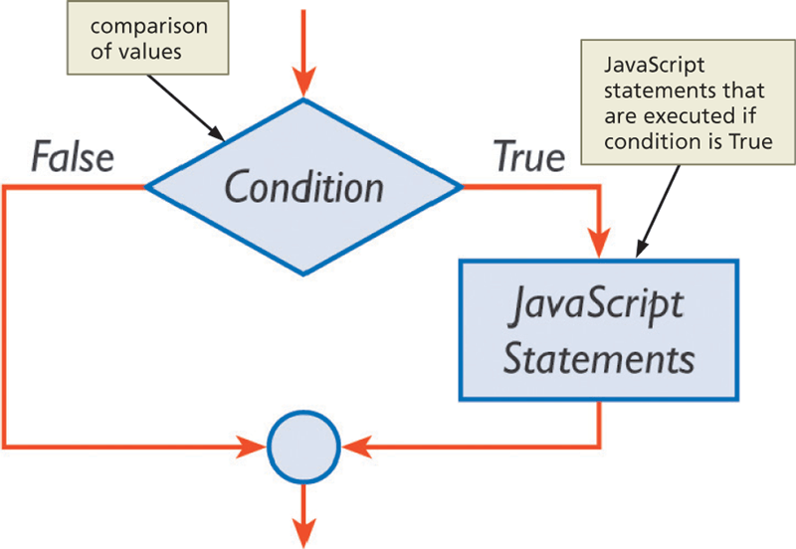
Entering an If Statement

Slide 13
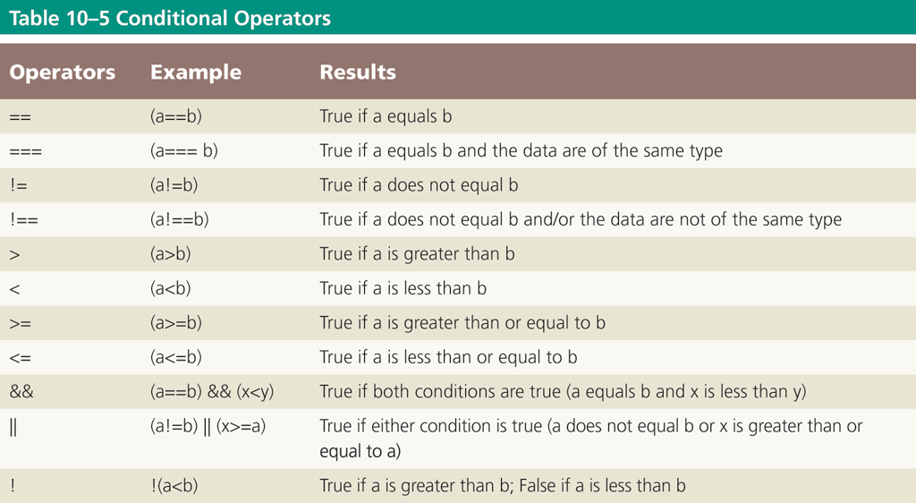
Entering an If Statement

Slide 14
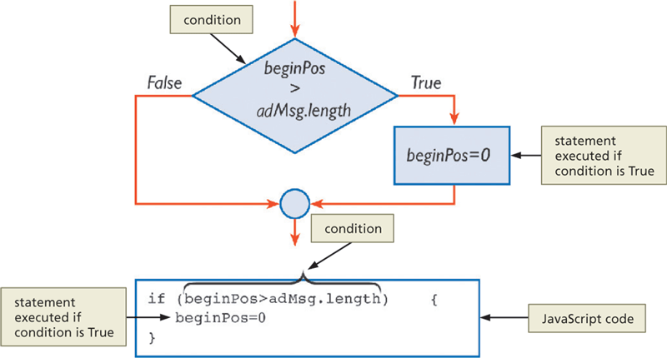
Entering an If Statement

Slide 15
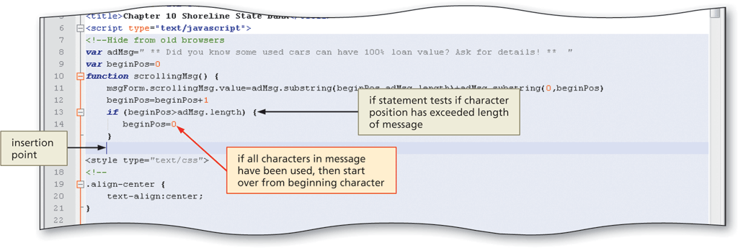
Entering an If Statement
Filename: index10.html

Slide 16
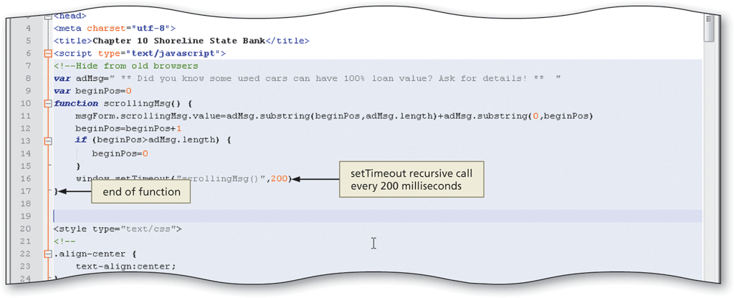
Adding the setTimeout() Method to Create a Recursive Call
Filename: index10.html

Slide 17
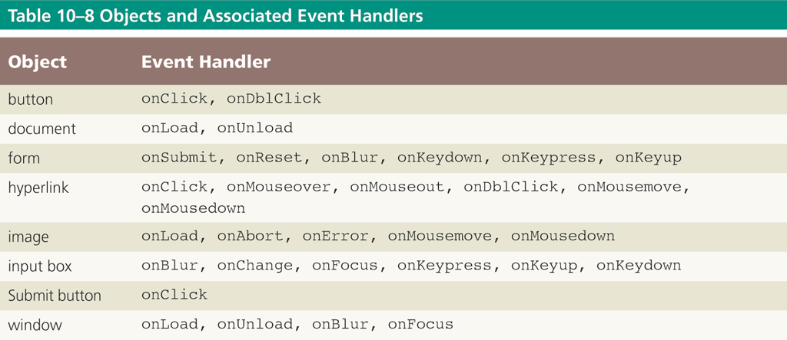
Objects and Associated Event Handlers

Slide 18
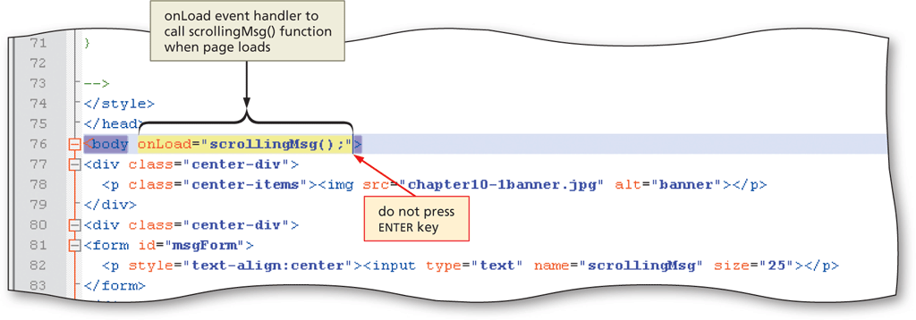

Entering the onLoad Event Handler to Call the scrollingMsg() Function
Filename: index10.html

Slide 19
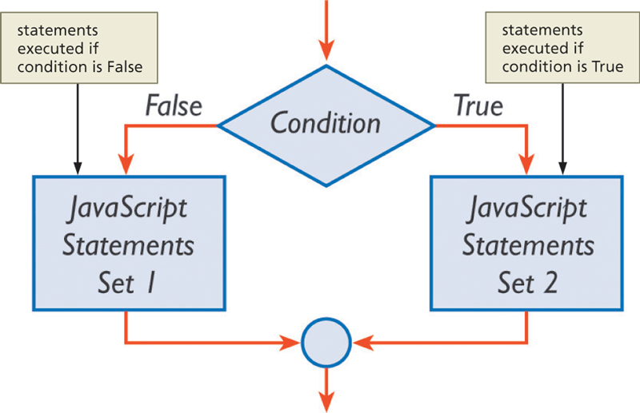
Validating Forms Using Nested if…else Statements

Slide 20
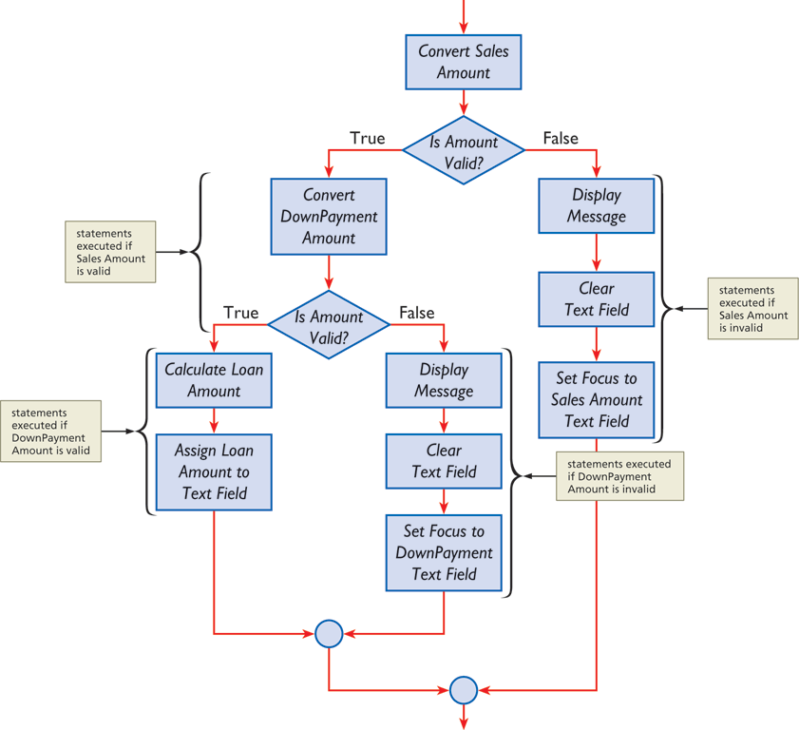
Validating Forms Using Nested if…else Statements

Slide 21
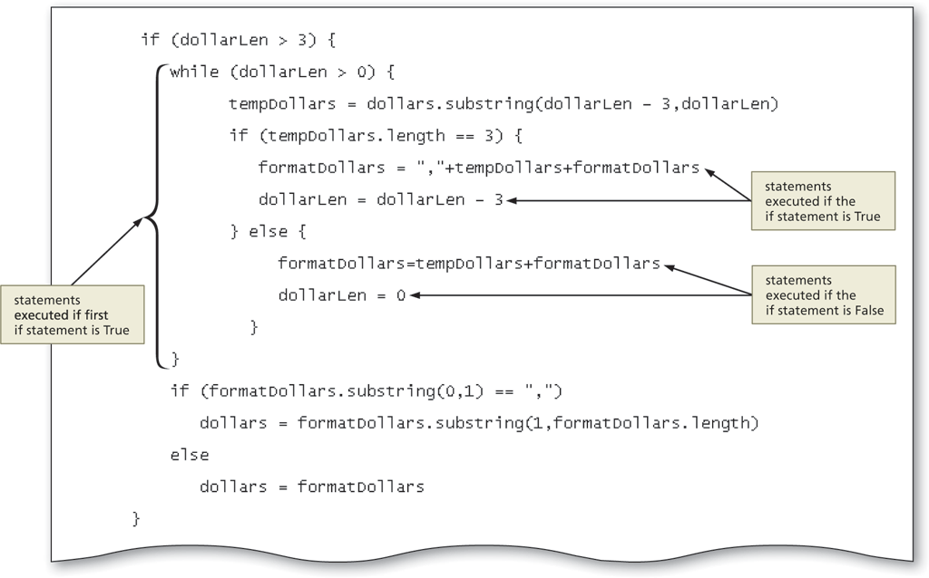
Validating Forms Using Nested if…else Statements

Slide 22
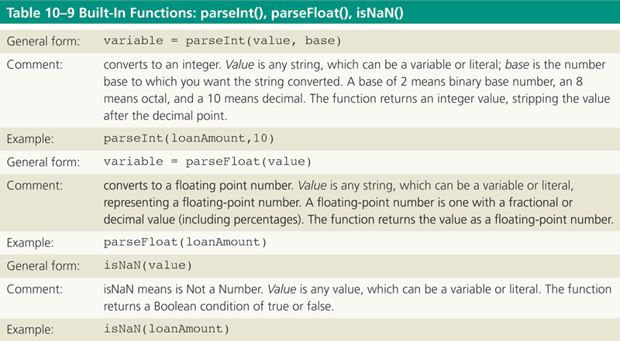
Using Built-In Functions to Validate Data

Slide 23
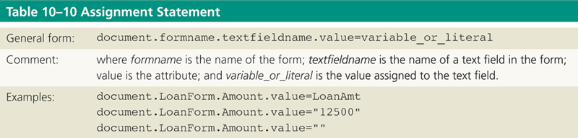
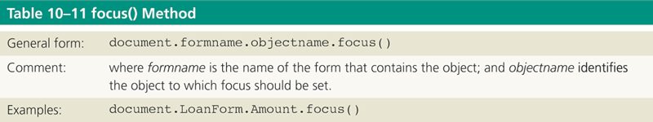
Using Built-In Functions to Validate Data

Slide 24
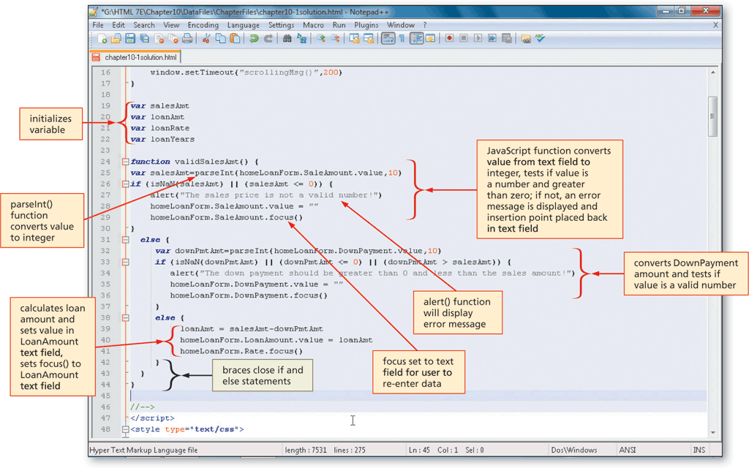
Adding the valSalesAmt() Function with Nested if…else Statements to Validate Form Data

Slide 25
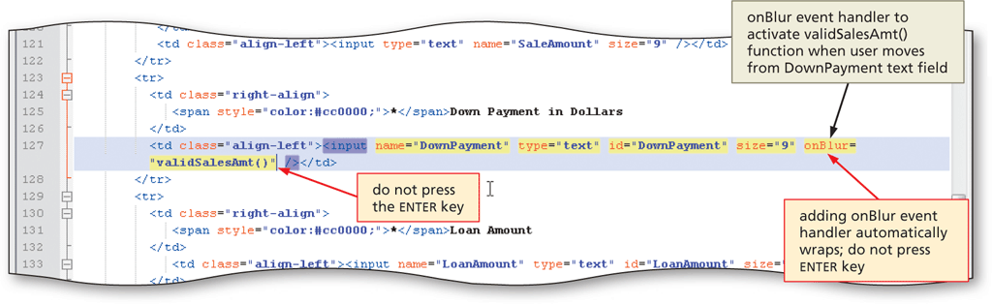
Entering the onBlur Event Handler to Call the valSalesAmt() Function

Slide 26
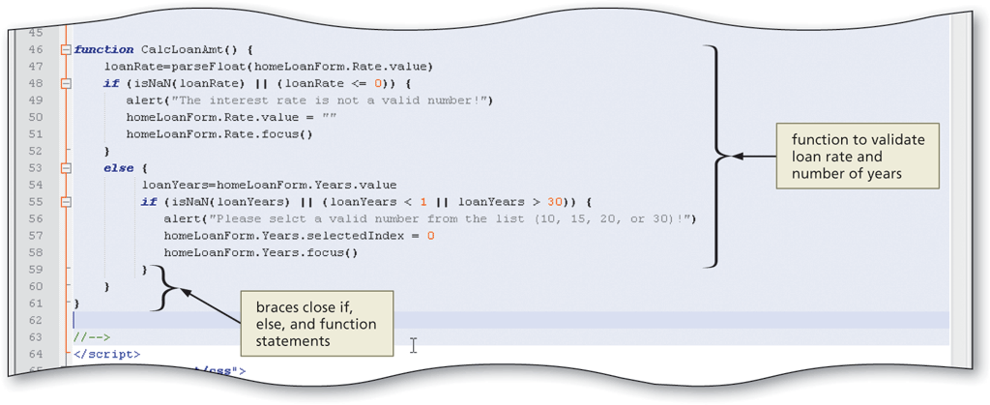
Entering the CalcLoanAmt() User-Defined Function

Slide 27
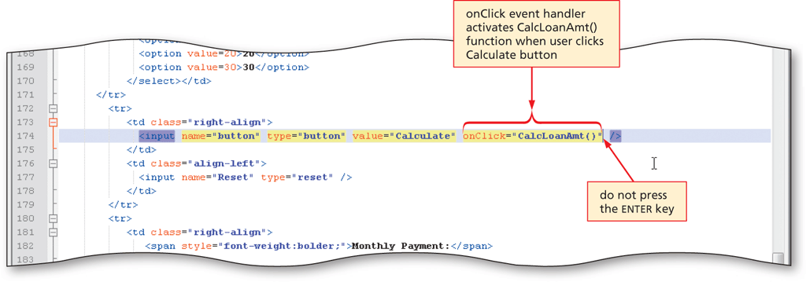
Entering an onClick Event Handler to Call the CalcLoanAmt() Function

Slide 28
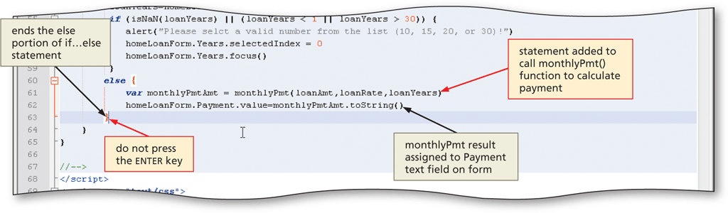
Entering Code to Call the monthlyPmt() Function

Slide 29
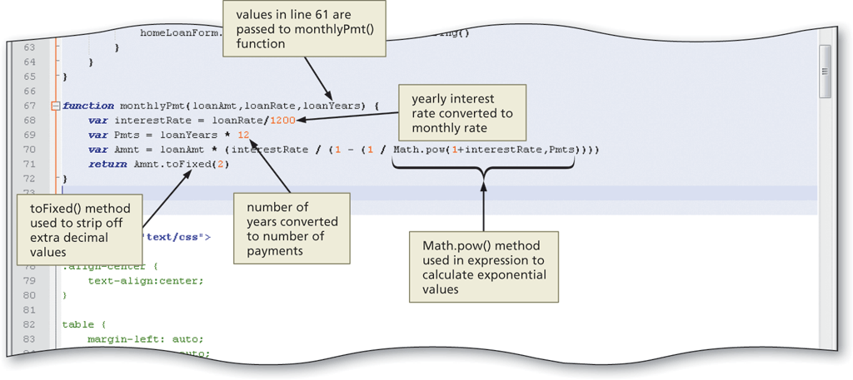
Creating the monthlyPmt() Function

Slide 30
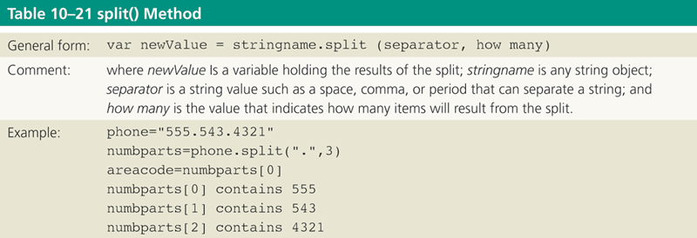
Split Method

Slide 31
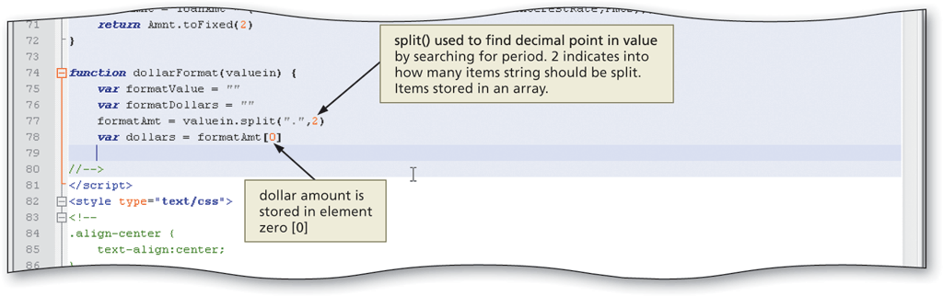
Entering the dollarFormat() Function

Slide 32
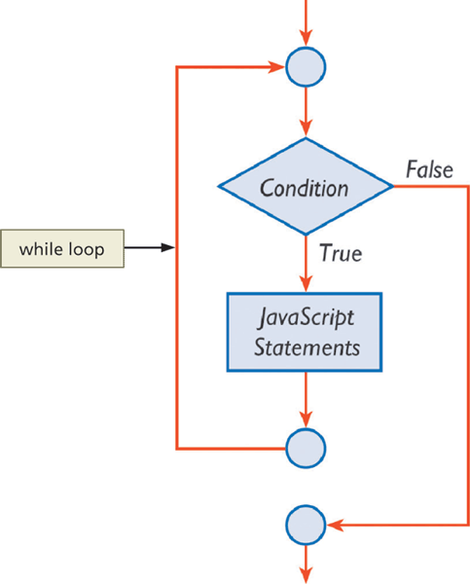
Using a while Loop an if…else Statement

Slide 33
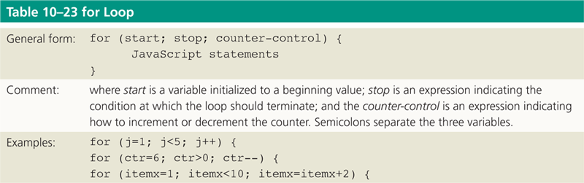
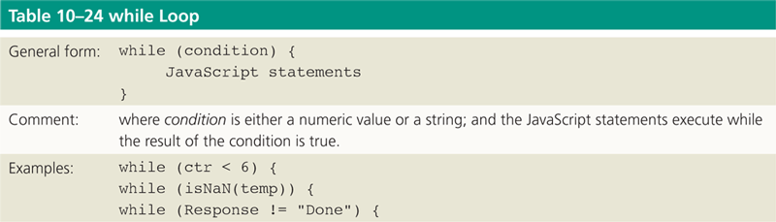
for Loops and while Loops

Slide 34
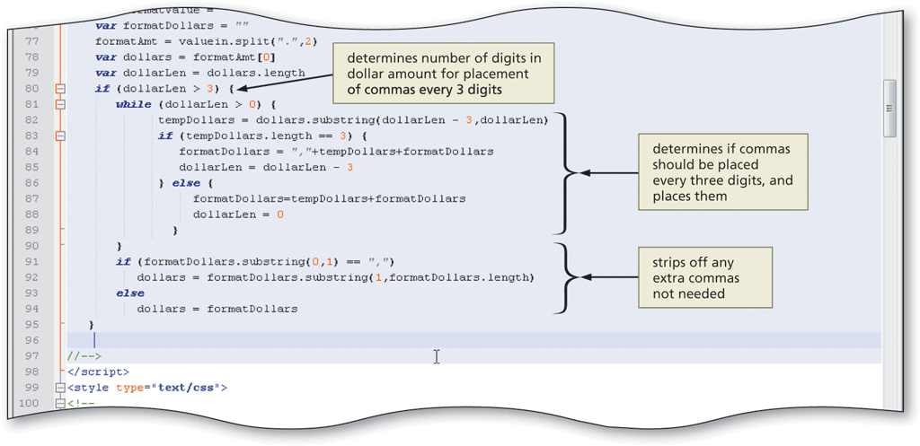
Entering an if…else Statement and While Loop to Extract the Dollar Portion of the Output and Insert Commas

Slide 35
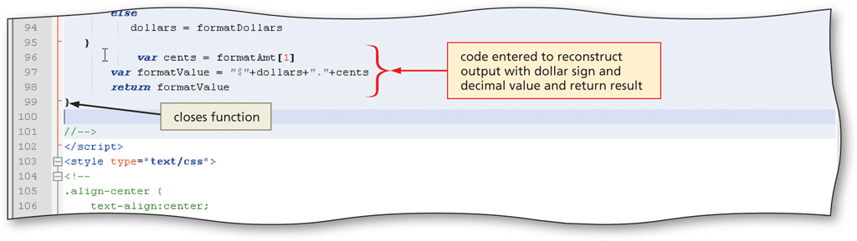
Reconstructing the Formatted Output and Returning the Formatted Value

Slide 36
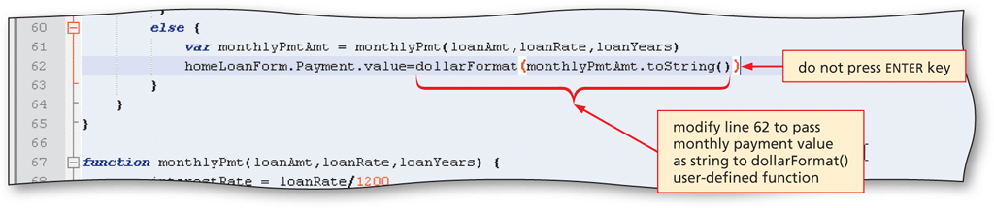
Passing the Monthly Payment Value to the dollarFormat() Function

Slide 37
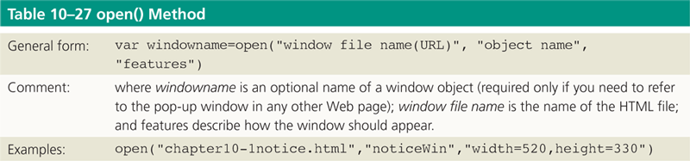
Adding a Pop-Up Window
A pop-up window appears over the previously opened browser window

Slide 38
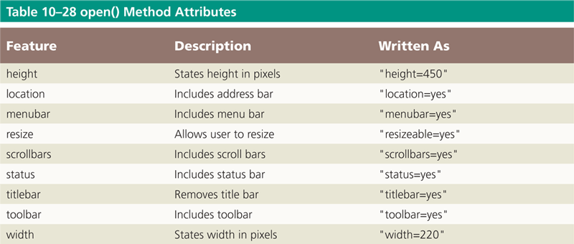
Adding a Pop-Up Window

Slide 39
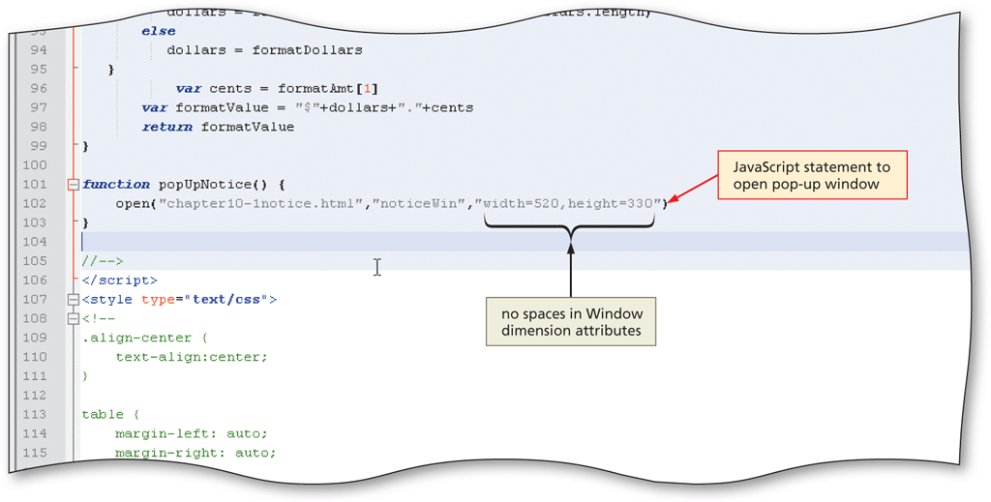
Entering the popUpNotice() Function to Open a Pop-up Window

Slide 40
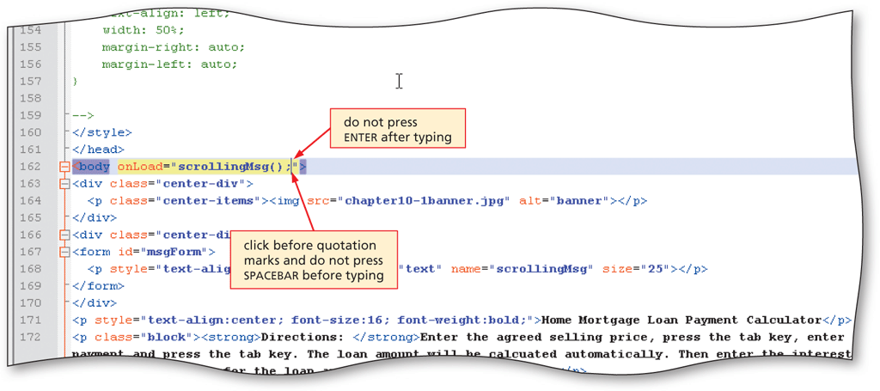
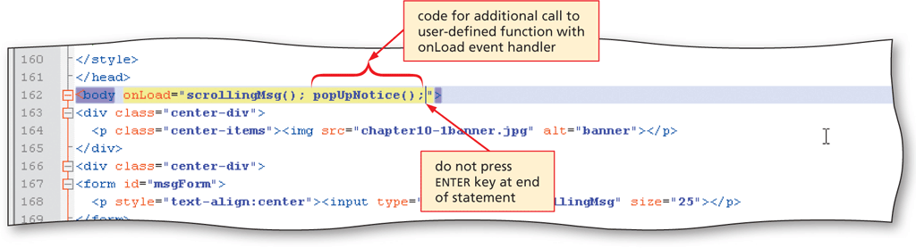
Adding the Event Handler to Call the popupNotice()Function

Slide 41
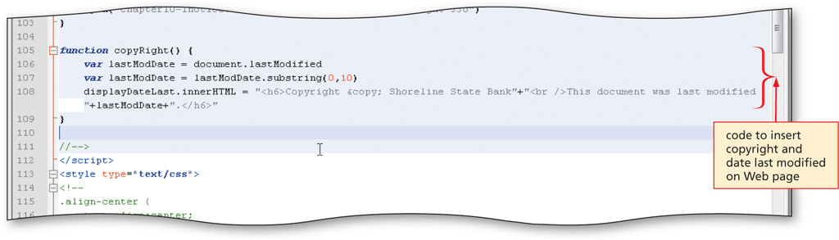
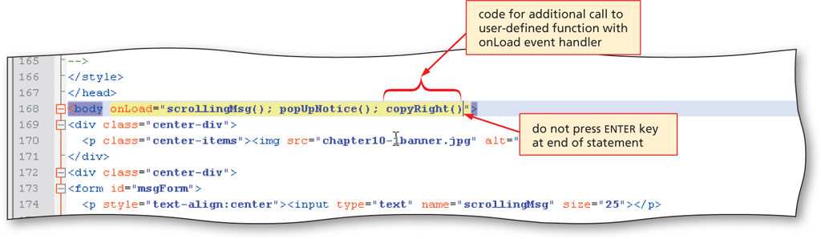
Displaying the Date Last Modified Using the substring() Method

Slide 42
Chapter Summary
Write a JavaScript user-defined function to display a scrolling message
Write a JavaScript user-defined function to validate form data
Write a JavaScript user-defined function to calculate a total loan amount based on a sales amount and down payment
Write a JavaScript user-defined function to calculate monthly loan payments

Slide 43
Chapter Summary
Define if and if...else statements, conditionals, and operands
Write a JavaScript user-defined function to format output in a text field
Describe how to open a pop-up window

Slide 44

A Short Academic-Integrity Presentation
What do we mean when we say "academic integrity"?
What are the 3 main kinds of academic misconduct?
What happens when we break academic integrity rules?
Common problem #1: paraphrasing
Common problem #2: citations
Common problem #3: quoting too much
A quiz! Of course there's a quiz.

Slide 45
A Short Academic-Integrity Presentation
What do we mean when we say "academic integrity"?
Being honest in your dealings as a student
Being ethical
Maintaining the value of higher education
Maintaining the quality of courses and learning experiences

Slide 46

A Short Academic-Integrity Presentation
2. What are the 3 main kinds of academic misconduct?
Contract cheating – asking/paying another person to create all or parts of an assessment and saying that it’s your own.
Using other people’s work (especially that of published researchers) without quoting, citing, and/or referencing accurately. This is plagiarism.
Using other people’s work, but not changing it sufficiently (e.g. not paraphrasing completely). This is also plagiarism.

Slide 47



A Short Academic-Integrity Presentation
3. What happens when we break academic integrity rules?
The percentage of your assignment that is plagiarised will not be assessed (~ % penalty).
Zero for the assessment in serious cases.
3. Zero for the unit in more serious cases.

Slide 48
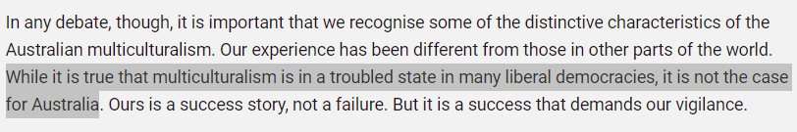
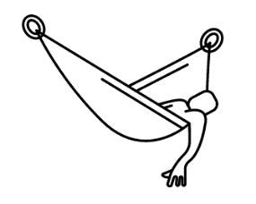


A Short Academic-Integrity Presentation
4. Common problem #1: lazy paraphrasing
Original:
Lazy
Studious
It is fact that multiculturalism is in a bad state in many countries, but it is not the situation in Australia (Australian Human Rights Commission 2016).
As the Australian Human Rights Commission (2016) points out, Australia does not have the problems with multiculturalism that many other liberal democracies have.
This is plagiarism

Slide 49
A Short Academic-Integrity Presentation
5. Common problem #2: citations
Author(s) family names
Space, no comma
Full stop after (not before)
(Taylor & Harrison 2016).
Parenthesis, no space before or after
Parenthesis, no space after
Year of publication

Slide 50
A Short Academic-Integrity Presentation
5. Common problem #2: citations for quotes
p, full stop, and a space
(Taylor & Harrison 2016, p. 11).
The page number
Comma and space

Slide 51
A Short Academic-Integrity Presentation
6. Common problem #3: quoting too much
According to the Australian Human Rights Commission (AHRC) (2016, p 16), ‘it is important that we recognise the some of the distinctive characteristics of Australian multiculturalism’. This is because ‘our experience has been different from those in other parts of the world’ (AHRC 2016, p 16). The AHRC (2016, p 16), claims that ‘ours is a success story, not a failure’, but that ‘it is a success story that demands our vigilance’.
Can you see the problem here?
Notes:
The problem here is that very little – basically none – of the discussion in this paragraph is original. The student hasn’t offered any insight, analysis, explanation, critique, exemplification or anything else that makes these ideas meaningful in the content of the assignment. Because so much of this is unoriginal, it can be seen as approaching plagiarism.

Slide 52
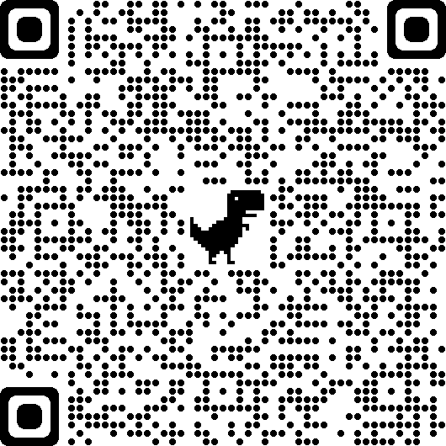
A Short Academic-Integrity Presentation
7. A quiz.
Link

Slide 53
A Short Academic-Integrity Presentation
Come and visit us at Academic Learning Support (ALS) for more help with academic integrity or any other learning matter.
Drop-in hours: 10AM-11AM and 2PM-3PM, Monday to Friday
ALS Melbourne
ZOOM: 713 695 7302
TEL: (03) 8353 0871
ALS Sydney
ZOOM 658 953 2737
TEL: (02) 9092 5171

Slide 54

kent.edu.au Kent Institute Australia Pty. Ltd. ABN 49 003 577 302 ● CRICOS Code: 00161E ● RTO Code: 90458 ● TEQSA Provider Number: PRV12051

